Slide 1







CATHAY HACKATHON 2024
CargoXcelerate
Overcoming competitions and unlocking new networks
BlackHats
Abrar Hossain
Dani K Martin
Safwan Abdal
Sahat Mahmud
Dawn K Martin
PolyU
PolyU
PolyU
PolyU
HKUST

Slide 2





CATHAY HACKATHON 2024
BlackHats

Slide 3



CATHAY HACKATHON 2024
BlackHats

Slide 4
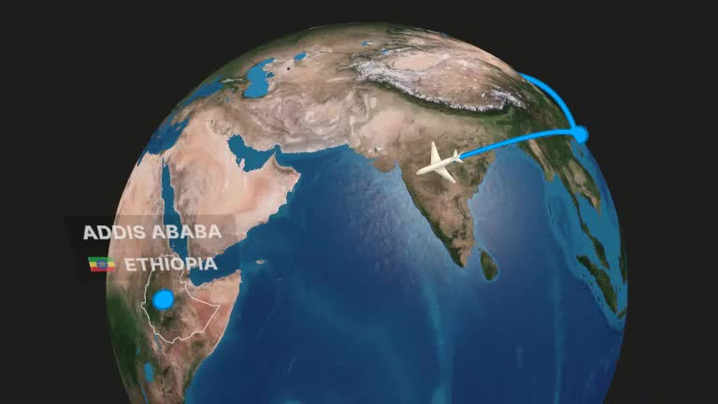
DELAYED
CANCELLED
HUGE TRANSIT

Slide 5

BlackHats
CATHAY HACKATHON 2024
MEDICATION NOT DELIVERED ON TIME

Slide 6
BlackHats
CATHAY HACKATHON 2024

Slide 7


CATHAY HACKATHON 2024
CargoXcelerate
Capitalizing on disruptions
Providing accelerated delivery timeframe.
BlackHats

Slide 8
Business Incentives
CATHAY HACKATHON 2024
Capitalizing on disruptions
Accelerated delivery
Optimizing Revenue
Fast-Track Shipping
Leverage on Competitor flight disruption
Handling time-sensitive shipments with swift delivery
Analyse rival flight routes
Expanding Customer Outreach
Compare rival flight prices
Strengthened Cathay Cargo Brand Image
Hike prices up accordingly
BlackHats

Slide 9


Proposed Solution
CATHAY HACKATHON 2024
Central System
Monitoring Disruptions
Capitalizing on Disruption
Check for identical cathay and rival flight routes
Cargo Flight Detection
Route Extraction
Cathay have time advantage?
Price hike
Disruption Detection
Disruption Detected
Relevant customers notified
BlackHats

Slide 10
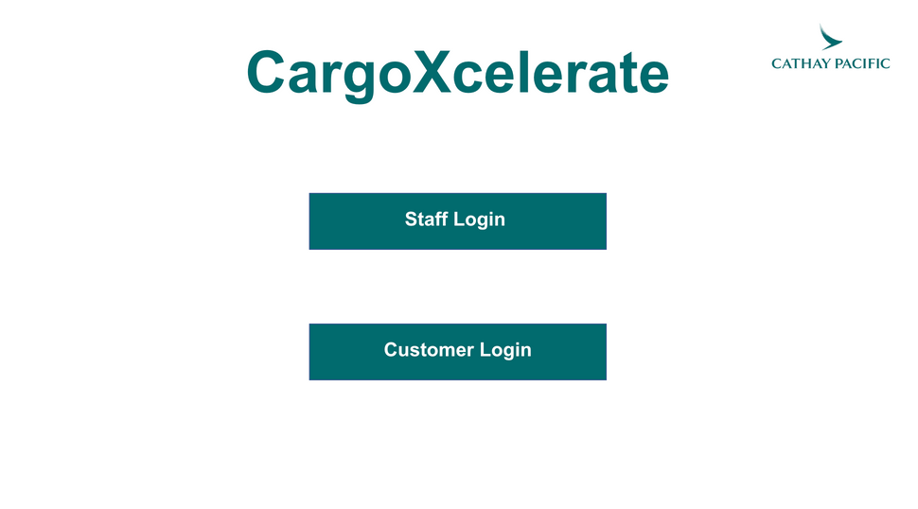
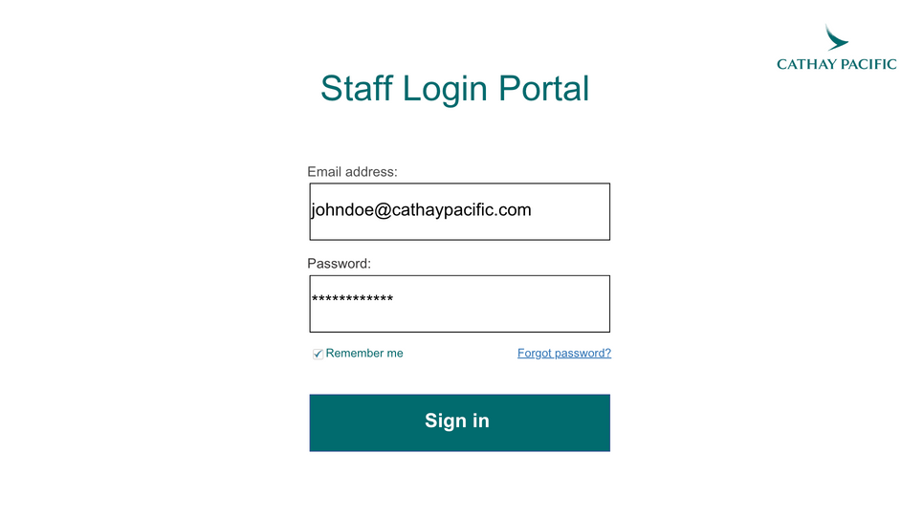
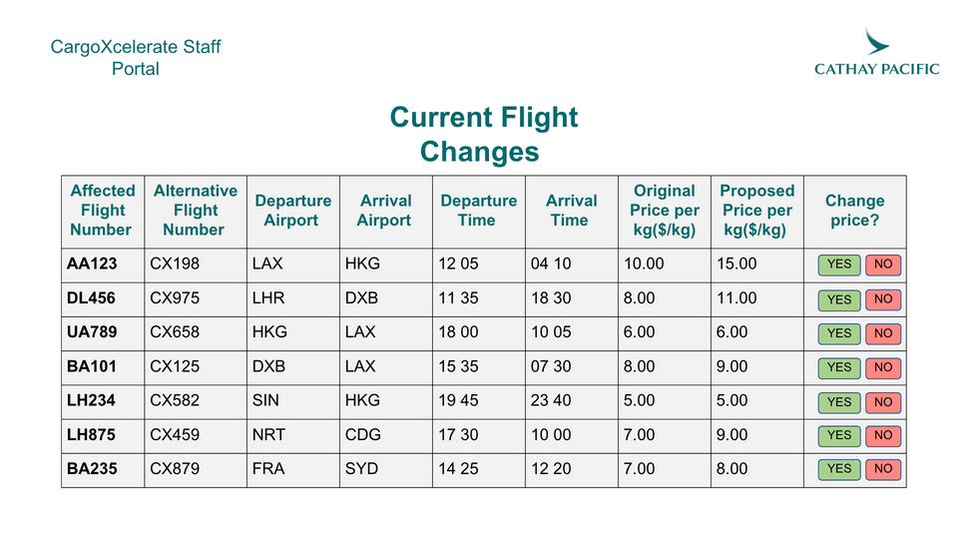
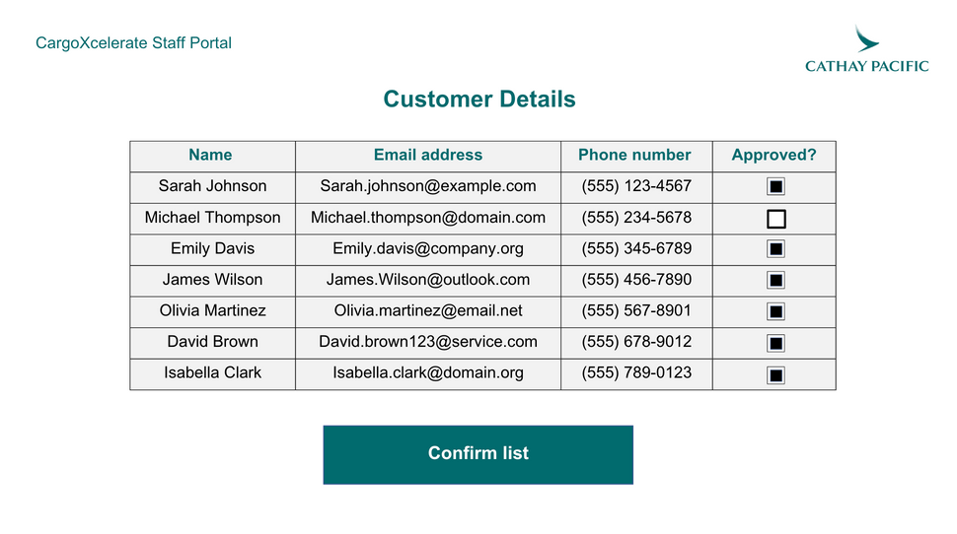
Proposed Solution (Front End)
CATHAY HACKATHON 2024

Slide 11
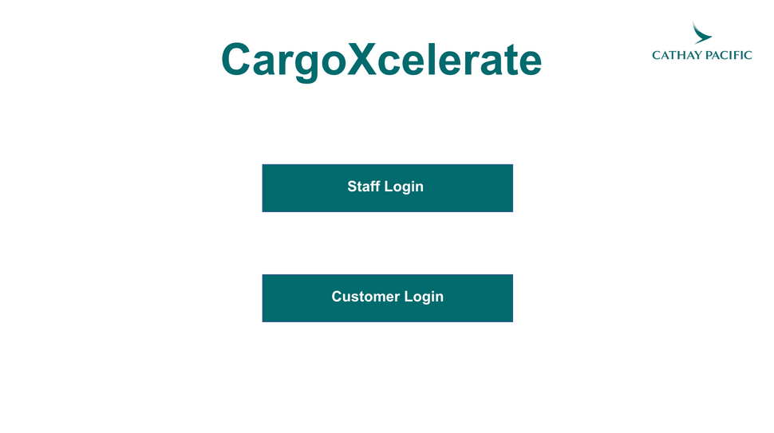
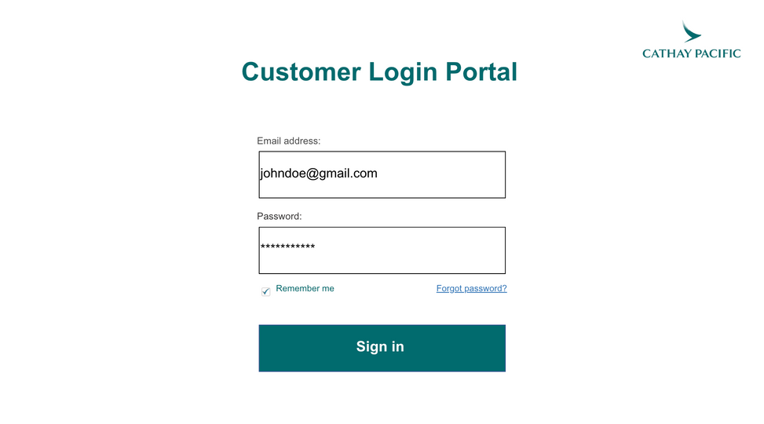
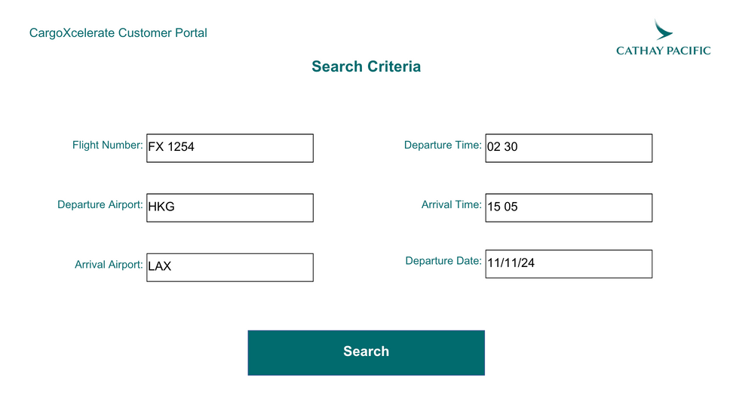
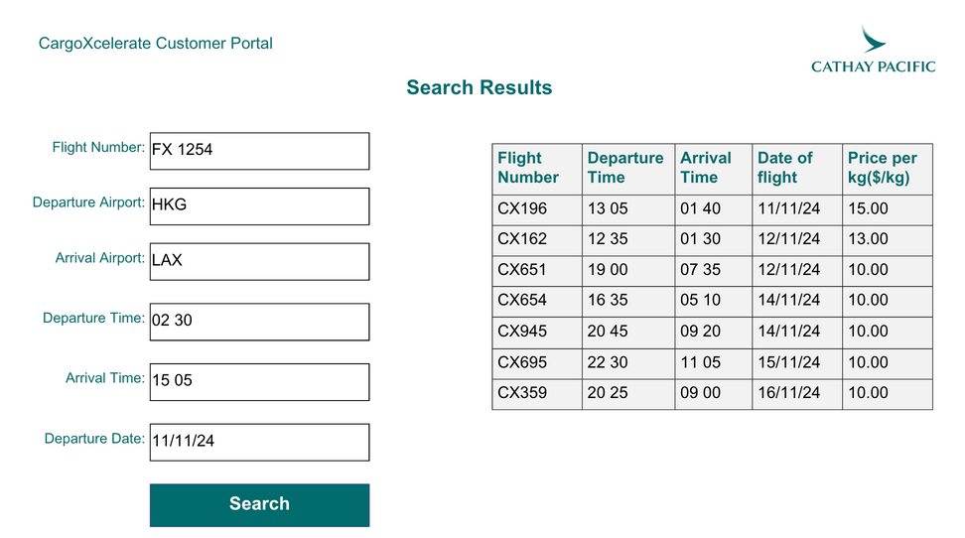
Proposed Solution (Front End)
CATHAY HACKATHON 2024

Slide 12
CATHAY DELIVERS-
ON TIME,
EVERY TIME.

Slide 13

CATHAY HACKATHON 2024
CARGOXCELERATE: EVERY PACKAGE, A CHANCE TO MAKE A DIFFERENCE
Q&A NOW!
BlackHats

